Slide 1
Working with Files and System.IO

Slide 2
Objectives
Overview System.IO
Explain about File and FileInfo class
Explain about Directory and DirectoryInfo class
Explain and Demo about FileStream class
Demo about File and FileInfo class
Demo about Directory and DirectoryInfo class
Demo create Text file using StreamReader and StreamWriter
Demo create Binary file using BinaryWriter and BinaryReader

Slide 3

Understanding the Files
A file is a collection of bytes stored on a secondary storage device, which is generally a disk of some kind
A memory location that has a name
File can be used as an extra memory to store a large amount of data temporarily or permanently
Each file ends with a marking-end-character or a number of bytes

Slide 4
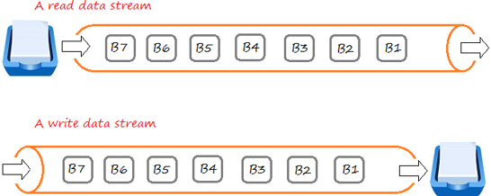
Understanding the Files
Stream: a chunk of data (sequence of bytes) containing information being passed through to store in memory storage

Slide 5
Exploring the System.IO Namespace
In the .NET, the System.IO namespace is the region of the base class libraries devoted to file-based (and memory-based) input and output (I/O) services
System.IO defines a set of classes, interfaces, enumerations, structures, and delegates, most of which we can find in mscorlib.dll
The types contained within mscorlib.dll, the System.dll assembly defines additional members of the System.IO namespace

Slide 6
Exploring the System.IO Namespace
Class Type | Description
BinaryReader BinaryWriter | These types allow to store and retrieve primitive data types (integers, Booleans, strings, and whatnot) as a binary value
BufferedStream | This type provides temporary storage for a stream of bytes that may be committed to storage at a later time
Directory DirectoryInfo | Use these classes to manipulate a machine’s directory structure. The Directory type exposes functionality using static members, while the DirectoryInfo type exposes similar functionality from a valid object reference
DriveInfo | This class provides detailed information regarding the drives that a given machine uses
File FileInfo | Use these classes to manipulate a machine’s set of files. The File type exposes functionality using static members, while the FileInfo type exposes similar functionality from a valid object reference

Slide 7
Exploring the System.IO Namespace
Class Type | Description
FileStream | This class gives you random file access (e.g., seeking capabilities) with data represented as a stream of bytes
FileSystemWatcher | This class allows you to monitor the modification of external files in a specified directory
MemoryStream | This class provides random access to streamed data stored in memory rather than in a physical file
Path | This class performs operations on System.String types that contain file or directory path information in a platform-neutral manner
StreamWriter StreamReader | You use these classes to store (and retrieve) textual information to (or from) a file. These types do not support random file access
StringWriter StringReader | Like the StreamReader/StreamWriter classes, these classes also work with textual information. However, the underlying storage is a string buffer rather than a physical file

Slide 8
Working with Files and Directories
C# provides the following classes to work with the File system. They can be used to access directories, access files, open files for reading or writing, create a new file or move existing files from one location to another, etc
Class Name | Description
File | File is a static class that provides different functionalities like copy, create, move, delete, open for reading or /writing, encrypt or decrypt, check if a file exists, append lines or text to a file’s content, get last access time, etc.
FileInfo | The FileInfo class provides the same functionality as a static File class. We have more control on how you do read/write operations on a file by writing code manually for reading or writing bytes from a file

Slide 9
Working with Files and Directories
Class Name | Description
Directory | Directory is a static class that provides functionality for creating, moving, deleting and accessing subdirectories
DirectoryInfo | DirectoryInfo provides instance methods for creating, moving, deleting and accessing subdirectories
Path | Path is a static class that provides functionality such as retrieving the extension of a file, changing the extension of a file, retrieving the absolute physical path, and other path related functionalities

Slide 10

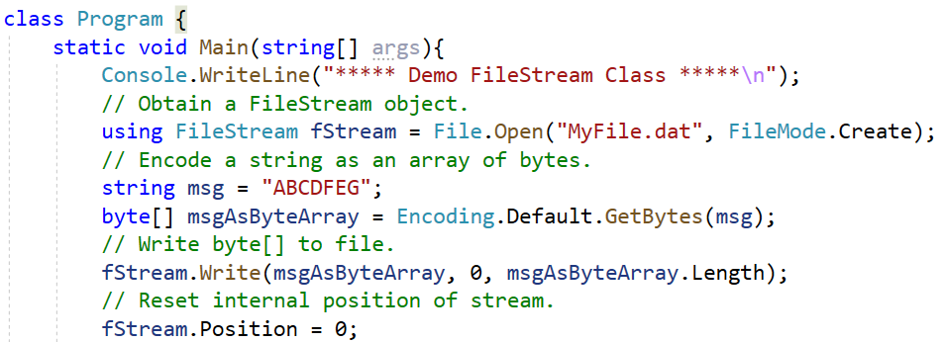
FileStream Class Demonstration
Provides a Stream for a file, supporting both synchronous and asynchronous read and write operations

Slide 11
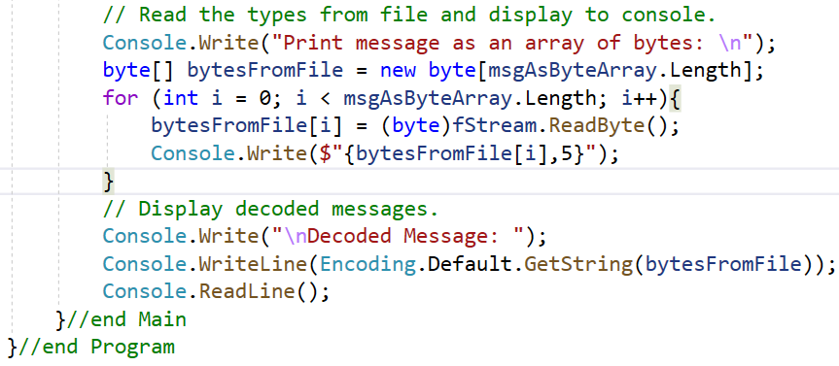
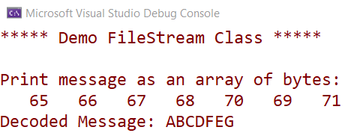
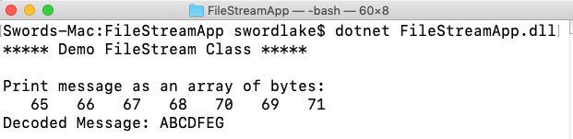
FileStream Class Demonstration
On Windows OS
On Mac OS

Slide 12
Working with File Class
File is a static class to read\write from physical file with less coding
Static File class provides functionalities such as create, read\write, copy, move, delete and others for physical files
The static File class includes various utility method to interact with physical file of any type e.g. binary, text etc. Use this static File class to perform some quick operation on physical file

Slide 13
Working with File Class
Important Methods of static File class
Method Name | Description
AppendAllLines | Appends lines to a file, and then closes the file. If the specified file does not exist, this method creates a file, writes the specified lines to the file, and then closes the file
AppendAllText | Opens a file, appends the specified string to the file, and then closes the file. If the file does not exist, this method creates a file, writes the specified string to the file, then closes the file
AppendText | Creates a StreamWriter that appends UTF-8 encoded text to an existing file, or to a new file if the specified file does not exist
Copy | Copies an existing file to a new file. Overwriting a file of the same name is not allowed
Create | Creates or overwrites a file in the specified path
CreateText | Creates or opens a file for writing UTF-8 encoded text

Slide 14
Working with File Class
Method Name | Description
Delete | Deletes the specified file
Decrypt | Decrypts a file that was encrypted by the current account using the Encrypt method
Encrypt | Encrypts a file so that only the account used to encrypt the file can decrypt it
Exists | Determines whether the specified file exists
GetAccessControl | Gets a FileSecurity object that encapsulates the access control list (ACL) entries for a specified file
Move | Moves a specified file to a new location, providing the option to specify a new file name
Open | Opens a FileStream on the specified path with read/write access
ReadAllBytes | Opens a binary file, reads the contents of the file into a byte array, and then closes the file

Slide 15
Working with File Class
Method Name | Description
ReadAllLines | Opens a text file, reads all lines of the file, and then closes the file
ReadAllText | Opens a text file, reads all lines of the file, and then closes the file
Replace | Replaces the contents of a specified file with the contents of another file, deleting the original file, and creating a backup of the replaced file
WriteAllBytes | Creates a new file, writes the specified byte array to the file, and then closes the file. If the target file already exists, it is overwritten
WriteAllLines | Creates a new file, writes a collection of strings to the file, and then closes the file
WriteAllText | Creates a new file, writes the specified string to the file, and then closes the file. If the target file already exists, it is overwritten

Slide 16
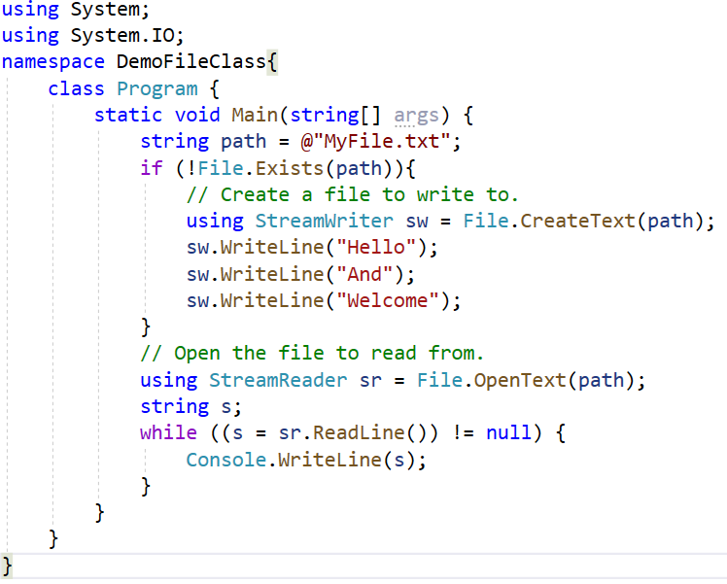
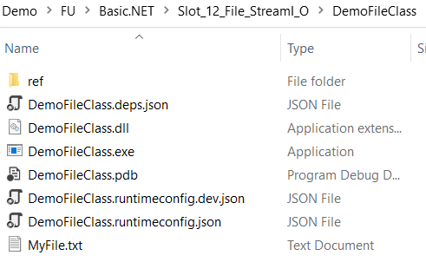
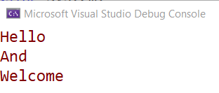
File Class Demonstration-01

Slide 17
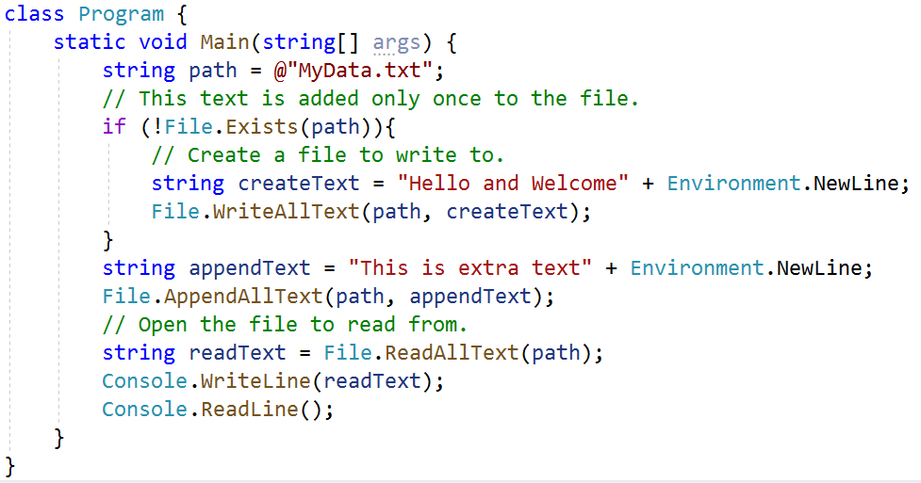
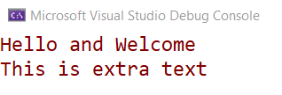
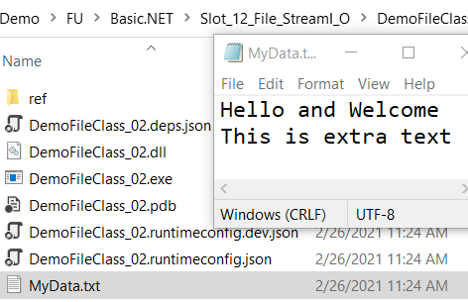
File Class Demonstration-02

Slide 18
Working with FileInfo Class
The FileInfo class provides the same functionality as the static File class but we have more control on read/write operations on files by writing code manually for reading or writing bytes from a file
Important Properties and Methods of FileInfo class:
Property Name | Description
Directory | Gets an instance of the parent directory
DirectoryName | Gets a string representing the directory's full path
Exists | Gets a value indicating whether a file exists

Slide 19
Working with FileInfo Class
Property Name | Description
Extension | Gets the string representing the extension part of the file
FullName | Gets the full path of the directory or file
IsReadOnly | Gets or sets a value that determines if the current file is read only
LastAccessTime | Gets or sets the time the current file or directory was last accessed
LastWriteTime | Gets or sets the time when the current file or directory was last written to
Length | Gets the size, in bytes, of the current file
Name | Gets the name of the file

Slide 20
Working with FileInfo Class
Method Name | Description
AppendText | Creates a StreamWriter that appends text to the file represented by this instance of the FileInfo
CopyTo | Copies an existing file to a new file, disallowing the overwriting of an existing file
Create | Creates a file
CreateText | Creates a StreamWriter that writes a new text file
Decrypt | Decrypts a file that was encrypted by the current account using the Encrypt method
Delete | Deletes the specified file
Encrypt | Encrypts a file so that only the account used to encrypt the file can decrypt it
GetAccessControl | Gets a FileSecurity object that encapsulates the access control list (ACL) entries for a specified file

Slide 21
Working with FileInfo Class
Method Name | Description
MoveTo | Moves a specified file to a new location, providing the option to specify a new file name
Open | Opens a in the specified FileMode
OpenRead | Creates a read-only FileStream
OpenText | Creates a StreamReader with UTF8 encoding that reads from an existing text file
OpenWrite | Creates a write-only FileStream
Replace | Replaces the contents of a specified file with the file described by the current FileInfo object, deleting the original file, and creating a backup of the replaced file
ToString | Returns a path as string

Slide 22
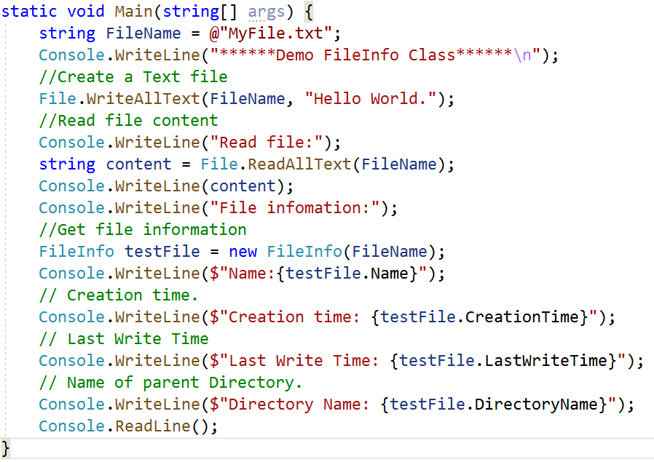
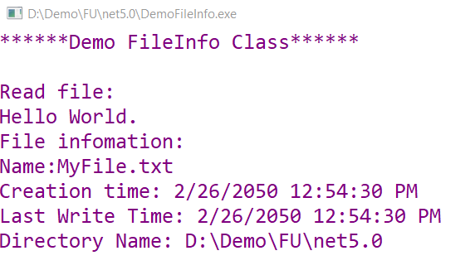
FileInfo Class Demonstration

Slide 23
Working with Directory Class
Exposes static methods for creating, moving, and enumerating through directories and subdirectories. This class cannot be inherited
Important methods of Directory class:
Method Name | Description
CreateDirectory(String) | Creates all directories and subdirectories in the specified path unless they already exist.
Delete(String) | Deletes an empty directory from a specified path.
EnumerateDirectories(String) | Returns an enumerable collection of directory full names in a specified path.

Slide 24
Working with Directory Class
Method Name | Description
EnumerateFiles(String) | Returns an enumerable collection of full file names in a specified path.
Exists(String) | Determines whether the given path refers to an existing directory on disk.
GetCurrentDirectory() | Gets the current working directory of the application.
GetDirectories(String) | Returns the names of subdirectories (including their paths) in the specified directory.
GetFiles(String) | Returns the names of files (including their paths) in the specified directory.
GetParent(String) | Retrieves the parent directory of the specified path, including both absolute and relative paths.
Move(String, String) | Moves a file or a directory and its contents to a new location.

Slide 25
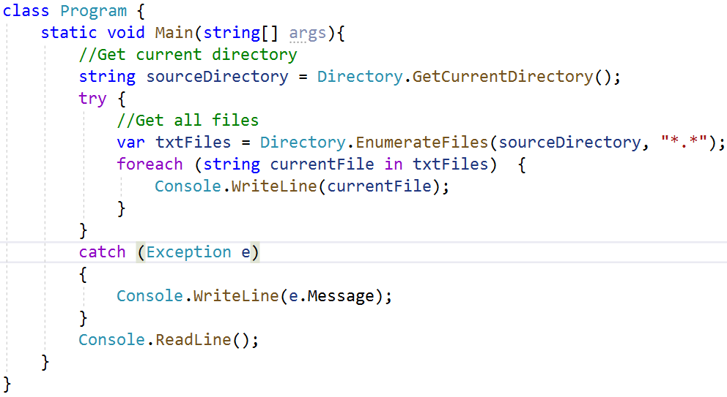
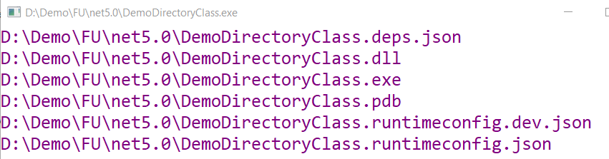
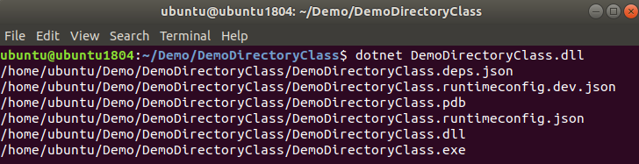
Directory Class Demonstration
On Windows OS
On Linux OS

Slide 26
Working with DirectoryInfo Class
Exposes instance methods for creating, moving, and enumerating through directories and subdirectories. This class cannot be inherited
Important Properties and Methods of DirectoryInfo class:
Property Name | Description
Attributes | Gets or sets the attributes for the current file or directory
CreationTime | Gets or sets the creation time of the current file or directory
Exists | Gets a value indicating whether the directory exists
Extension | Gets the string representing the extension part of the file
FullName | Gets the full path of the directory or file

Slide 27
Working with DirectoryInfo Class
Method Name | Description
Create() | Creates a directory
CreateSubdirectory(String) | Creates a subdirectory or subdirectories on the specified path. The specified path can be relative to this instance of the DirectoryInfo class
Delete() | Deletes this DirectoryInfo if it is empty
GetDirectories(String) | Returns an array of directories in the current DirectoryInfo matching the given search criteria
GetFiles(String) | Returns a file list from the current directory matching the given search pattern
MoveTo(String) | Moves a DirectoryInfo instance and its contents to a new path
GetFileSystemInfos(String) | Retrieves an array of strongly typed FileSystemInfo objects representing the files and subdirectories that match the specified search criteria

Slide 28
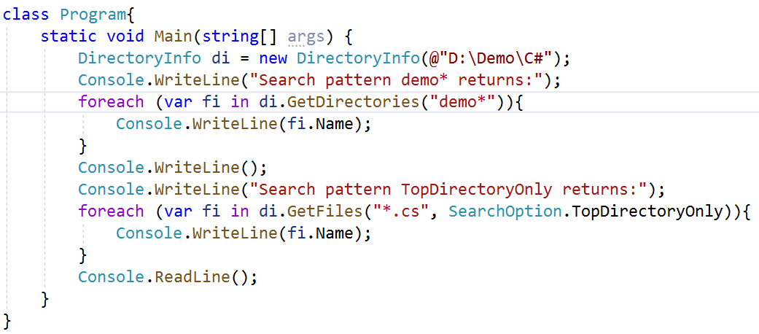
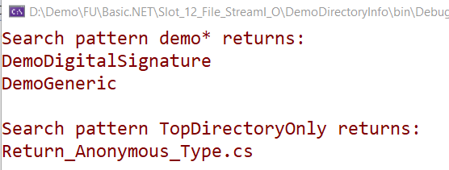
Working with DirectoryInfo Class Demonstration

Slide 29
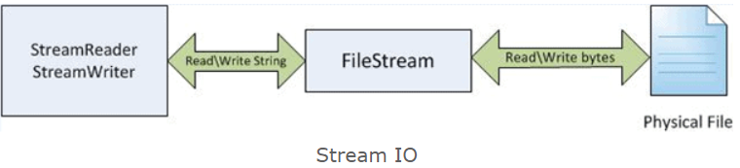
Working with StreamWriter and StreamReader
StreamReader: StreamReader is a helper class for reading characters from a Stream by converting bytes into characters using an encoded value. It can be used to read strings (characters) from different Streams like FileStream, MemoryStream, etc
StreamWriter: StreamWriter is a helper class for writing a string to a Stream by converting characters into bytes. It can be used to write strings to different Streams such as FileStream, MemoryStream, etc

Slide 30
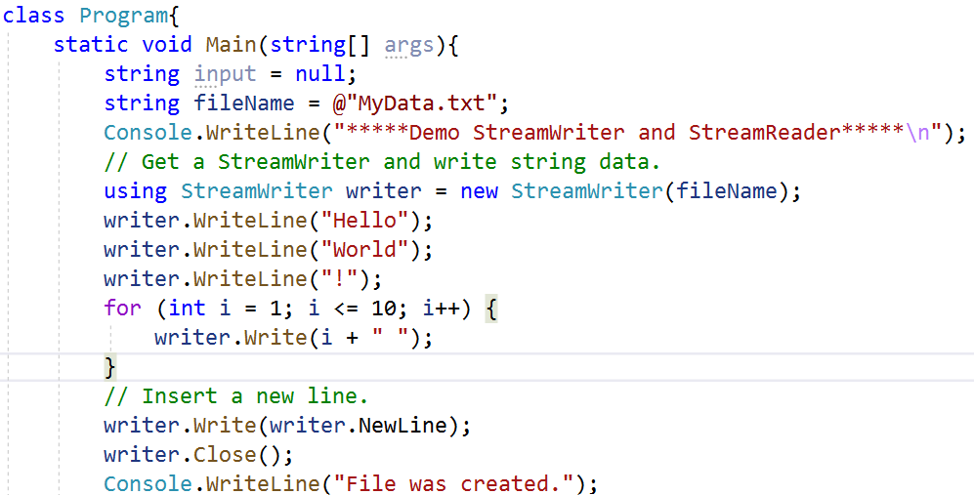
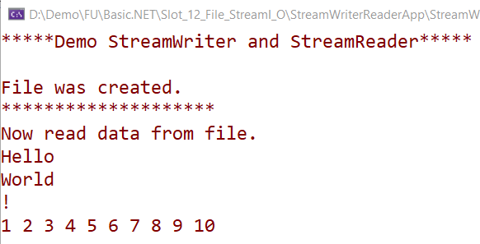
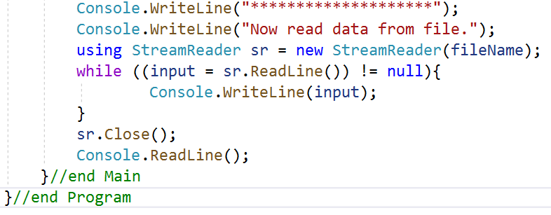
StreamWriter and StreamReader Demonstration

Slide 31
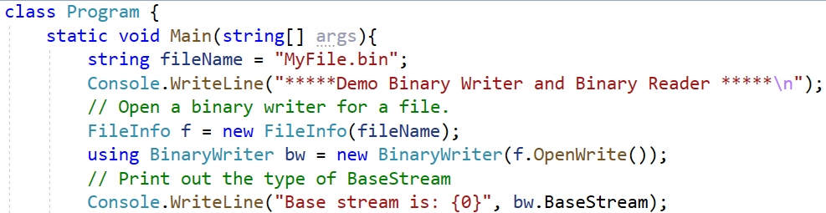
Working with BinaryWriter and BinaryReader
BinaryReader and BinaryWriter allow to read and write discrete data types to an underlying stream in a compact binary format

Slide 32
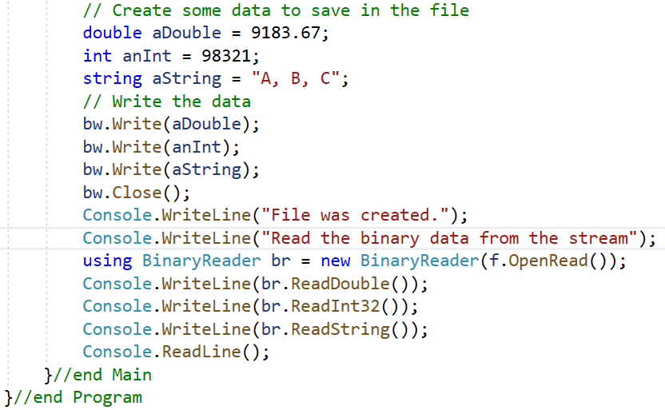
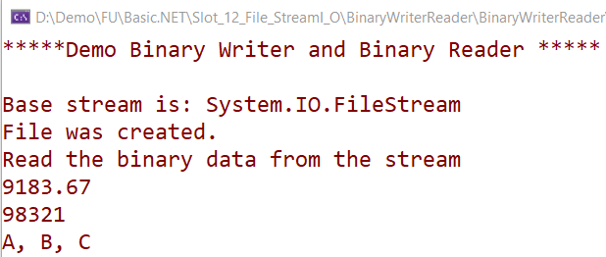
BinaryWriter and BinaryReader Demonstration

Slide 33
Summary
Concepts were introduced:
Overview about System.IO
Explain and Demo about FileStream class
Explain about File and FileInfo class
Explain about Directory and Directory Info class
Demo about File and FileInfo class
Demo about Directory and DirectoryInfo class
Demo create Text file using StreamReader and StreamWriter
Demo create Binary file using BinaryWriter and BinaryReader

